Slide 1

eSC Energy:
Predictions & Recommendations
Divya Raviraj Rao, Vaibhav Gaikwad, Punami Chowdary, Akshay Barku Avhad, Megan Kratzer

Slide 2
Project Goal
Understand historical energy usage and affecting factors
Provide recommendations on how to reduce overall energy usage
Predict next year’s energy usage based on increased temperatures
Determine the grid capacity needed to sustain energy usage for next year

Slide 3
Understanding the Data
House Data
Weather Data
Energy Data
Kept only July data (the hottest month)
Each house contains energy and weather information for each hour of July
We then aggregated by day for some modeling

Slide 4
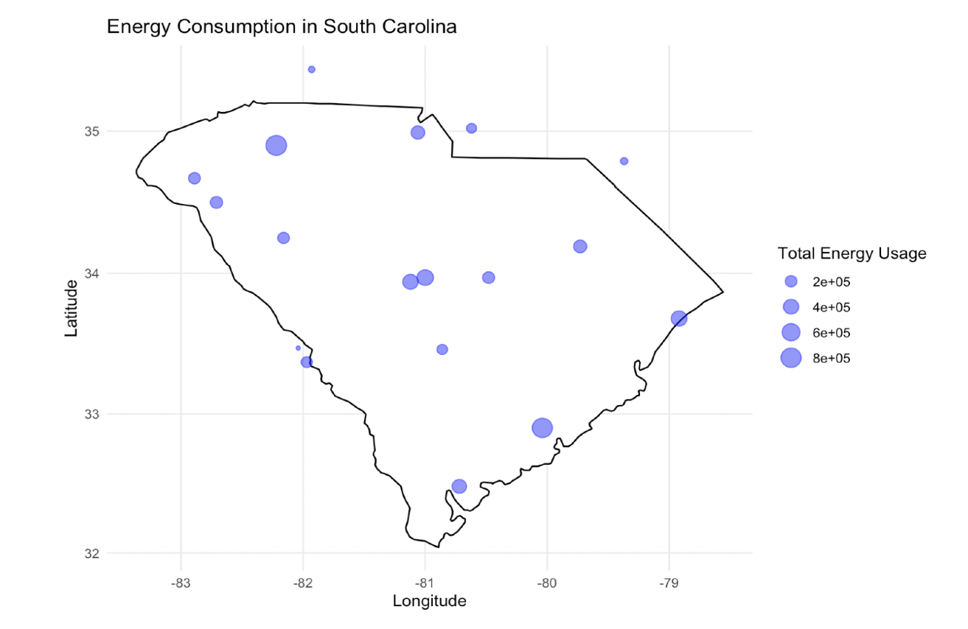



Map of City Energy Usage
The data was collected from major cities in South Carolina like Charleston, Myrtle Beach, Hilton Head, etc.
The cities with the highest energy usage include Goose Creek and North Charleston.

Slide 5
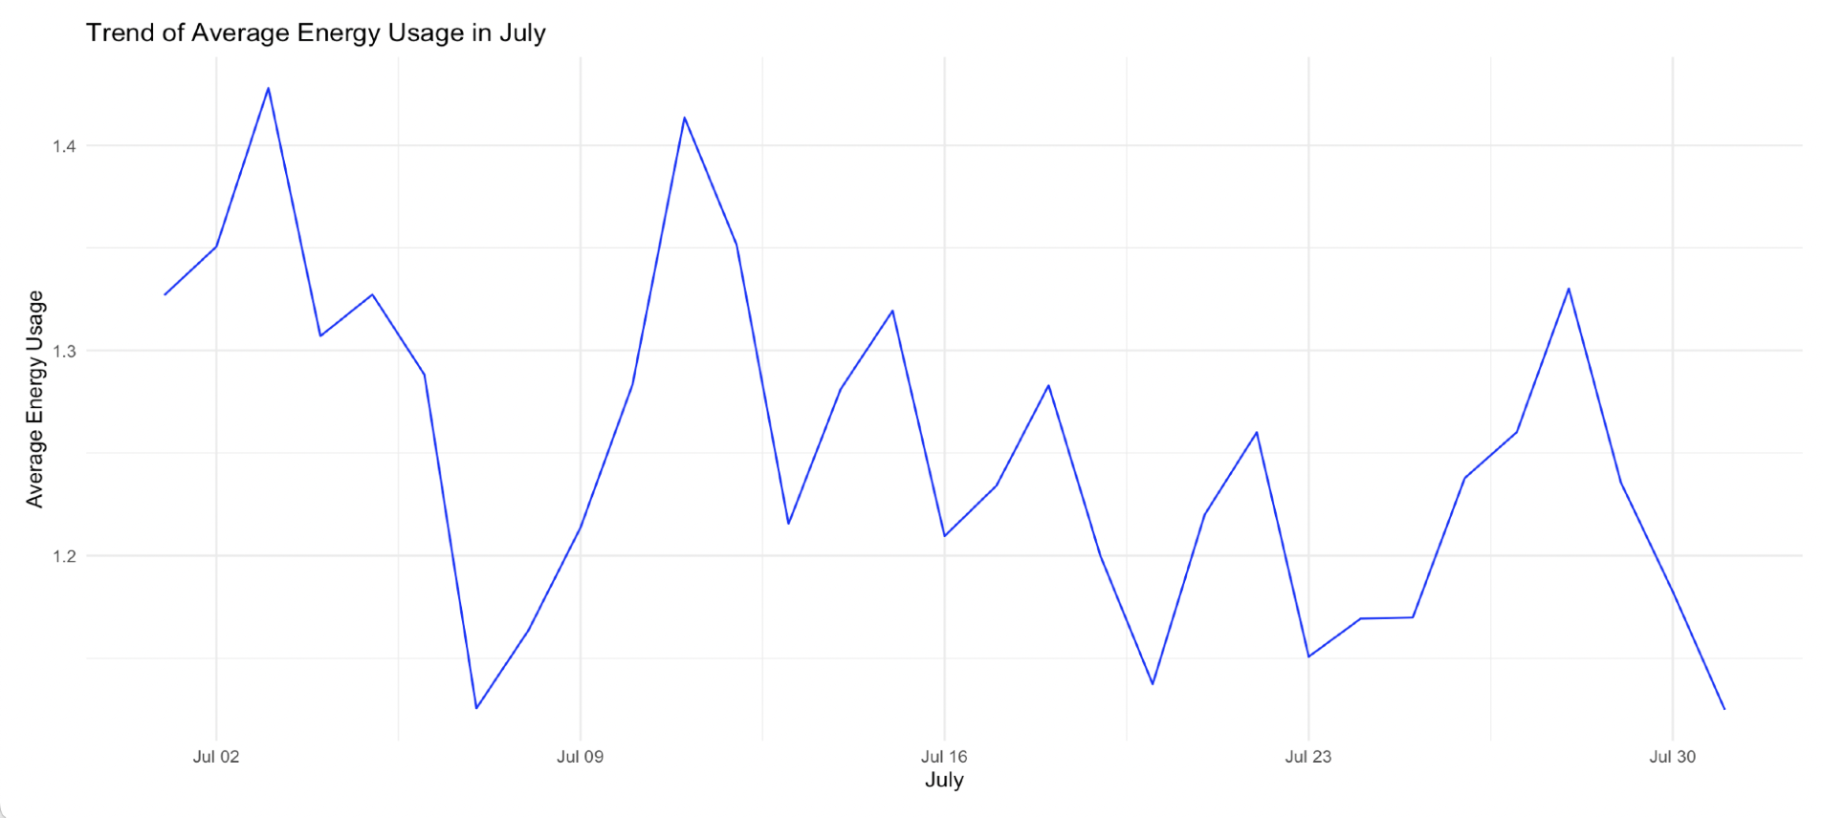
Patterns in Energy Usage - Historical

Slide 6
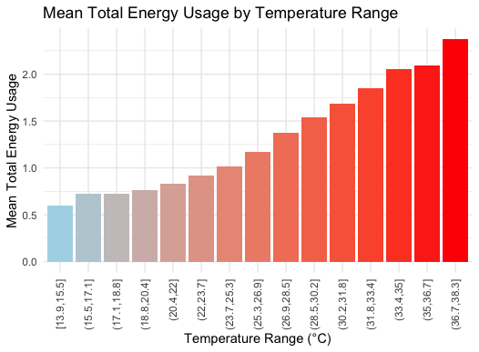
As temperature increases, so does energy usage

Slide 7


Variable Visualizations

Slide 8
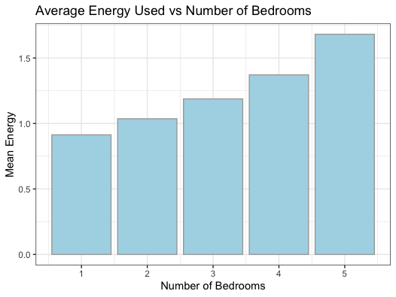
Number of Bedrooms & Energy
As the size of a house increases, so does the energy usage for the house

Slide 9
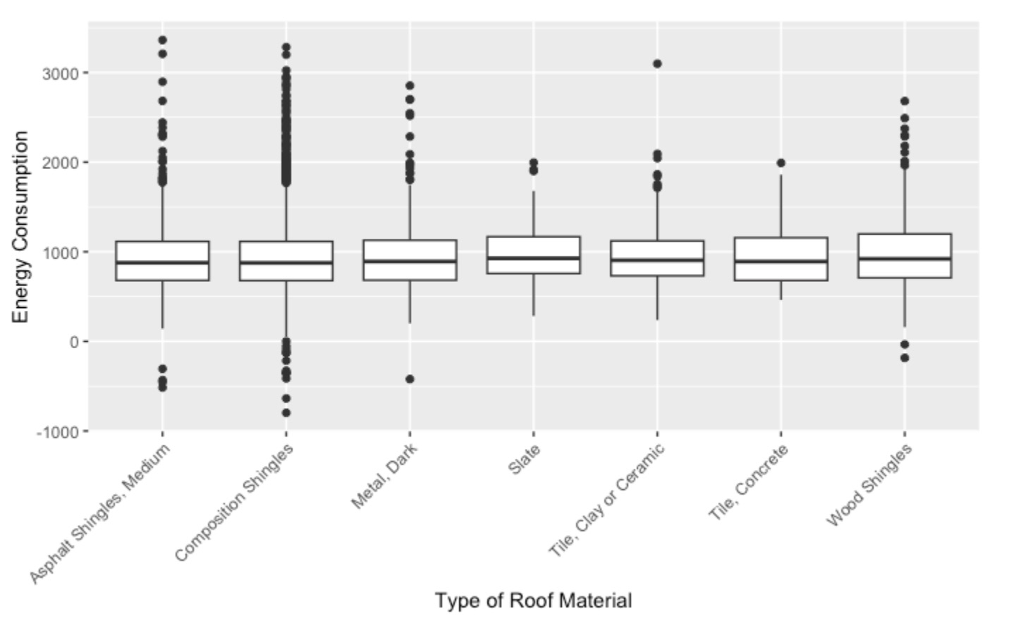
Difference in Energy Consumption based on Roof Material

Slide 10
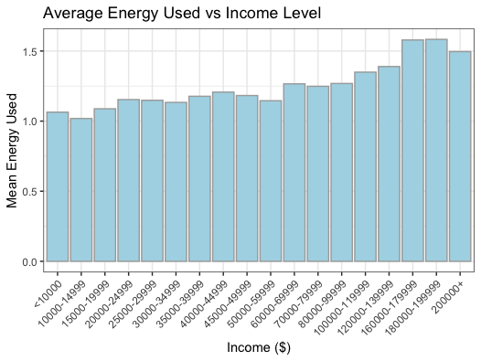
Average Energy Consumption vs Range of Income
As household income range increases, the house typically uses more energy

Slide 11
Which variables most impact energy use?
Example variables with
high significance:
County
Pool & Hot Tub
Solar Panels
Using ANOVA (statistical testing), we determined 40 variables relating to house data that had a significant impact on energy usage that we can use in our model
Light Type
Roof Material

Slide 12
Our Model
We can predict 85.3% of the change in energy usage using daily temperature and house information data.
On average, we are only 5.16 kWh off from the true daily energy usage.
Linear Regression

Slide 13
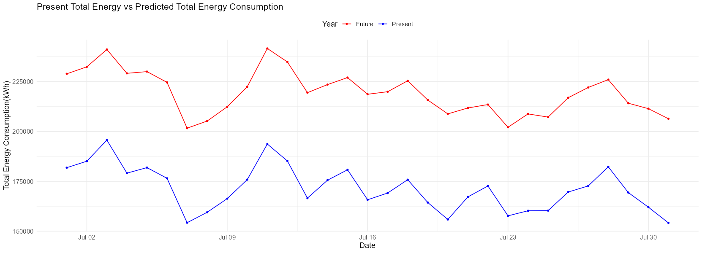
Predicted Total Energy Usage

Slide 14
Predicted grid capacity needed to account for all houses in South Carolina:
approx.
242901.3 kWh
The estimated max energy for a single
house is about 99 kWh

Slide 15
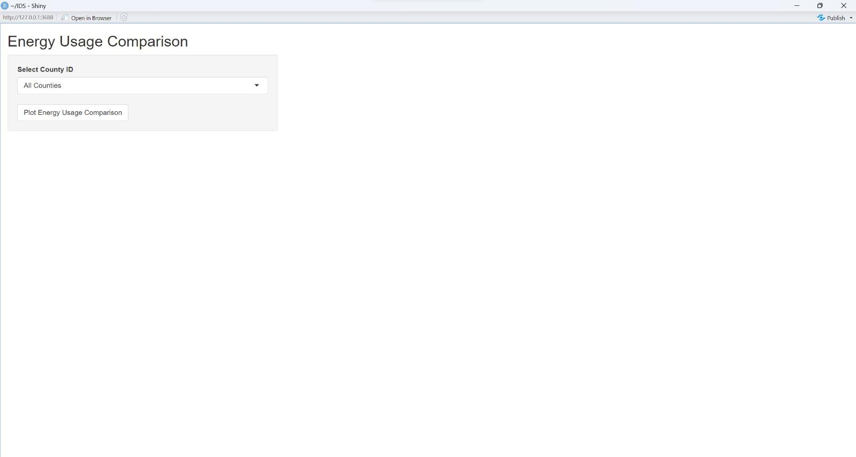
Shiny Application

Slide 16
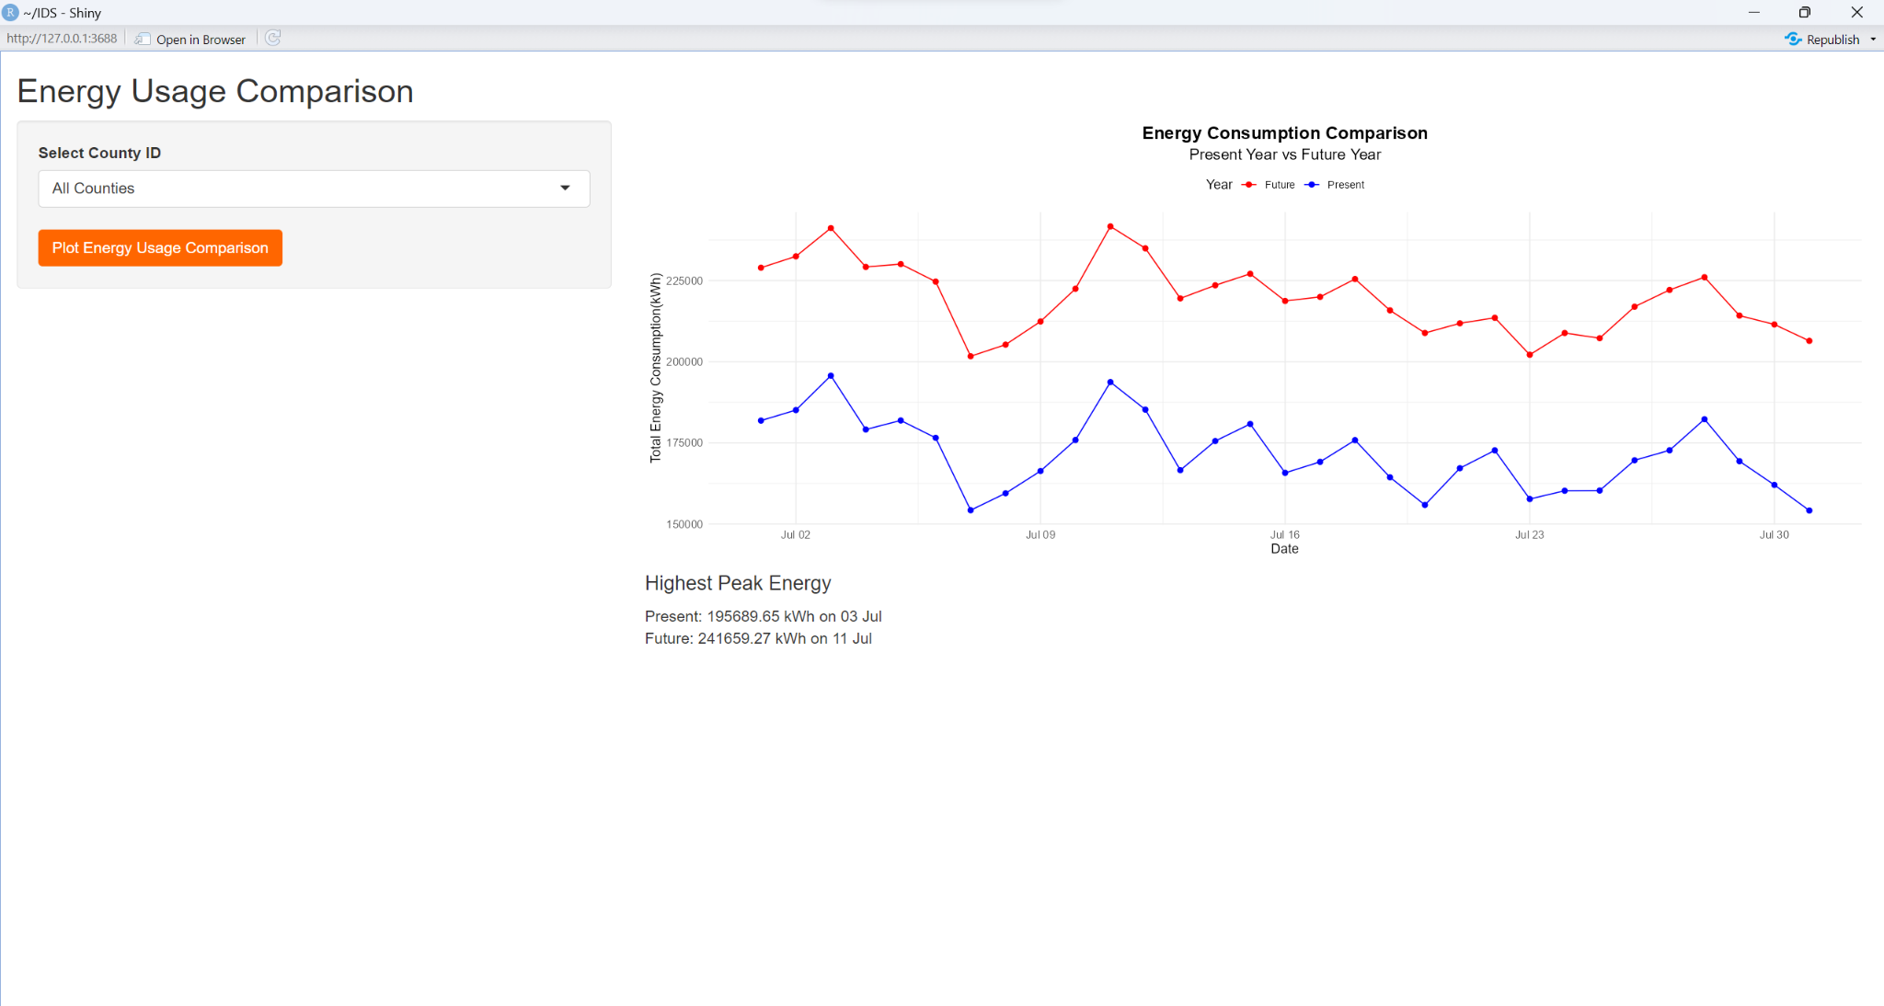
Shiny Application

Slide 17
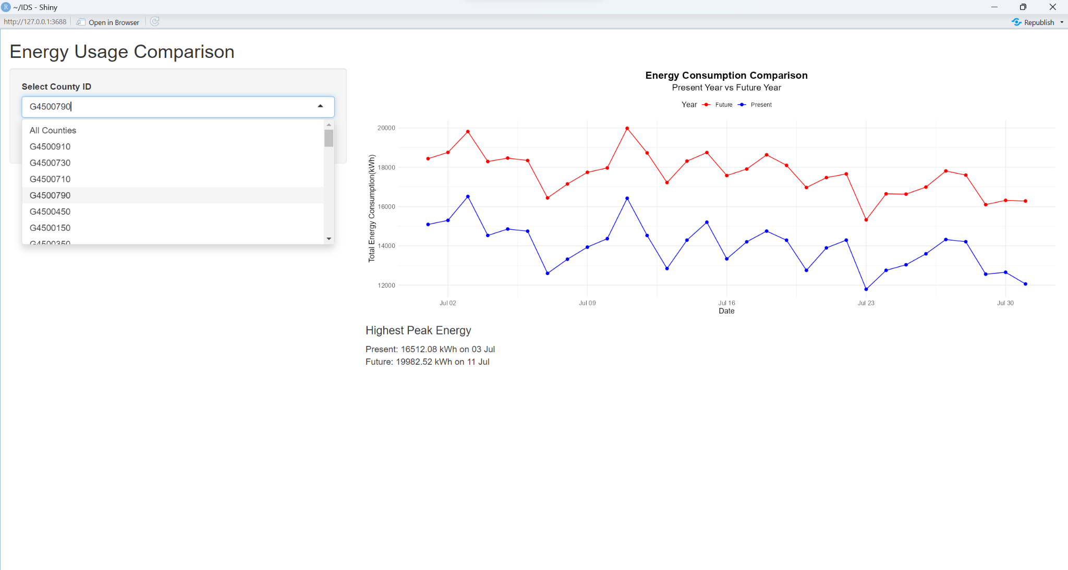
Shiny Application

Slide 18

Recommendations to Reduce Energy Usage:

Slide 19
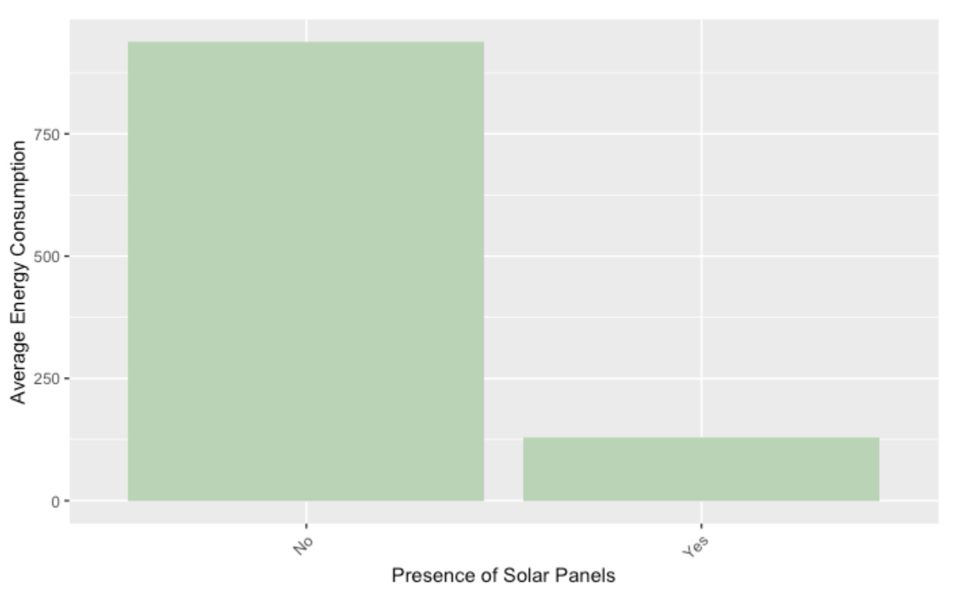
Solar panels drastically reduce energy usage:

Slide 20
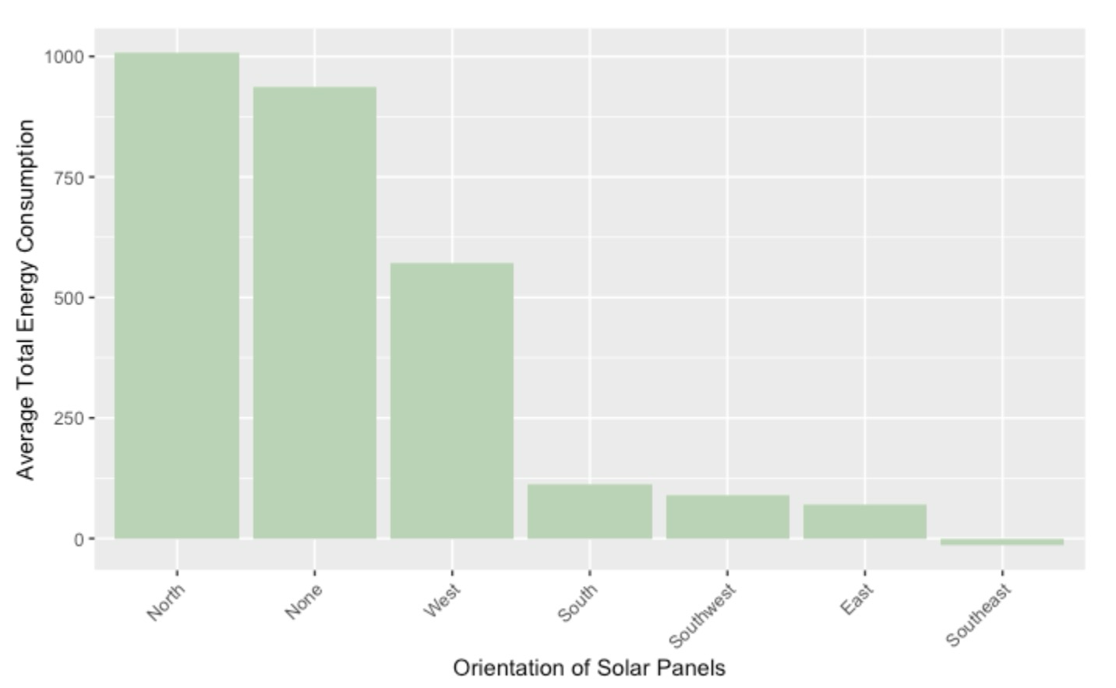
Recommended Orientation of Solar Panels - SouthEast

Slide 21
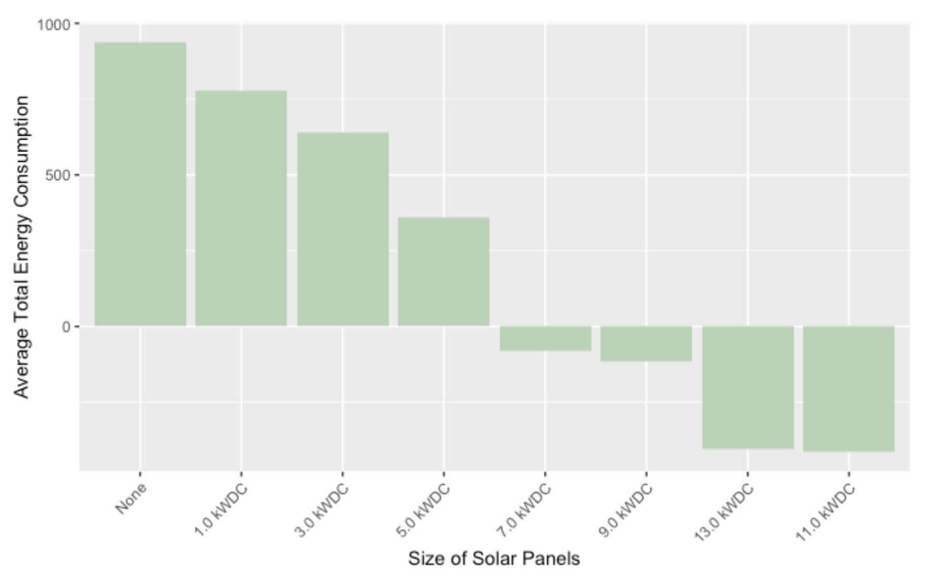
Recommended Size of Solar Panels - 11 kW DC

Slide 22
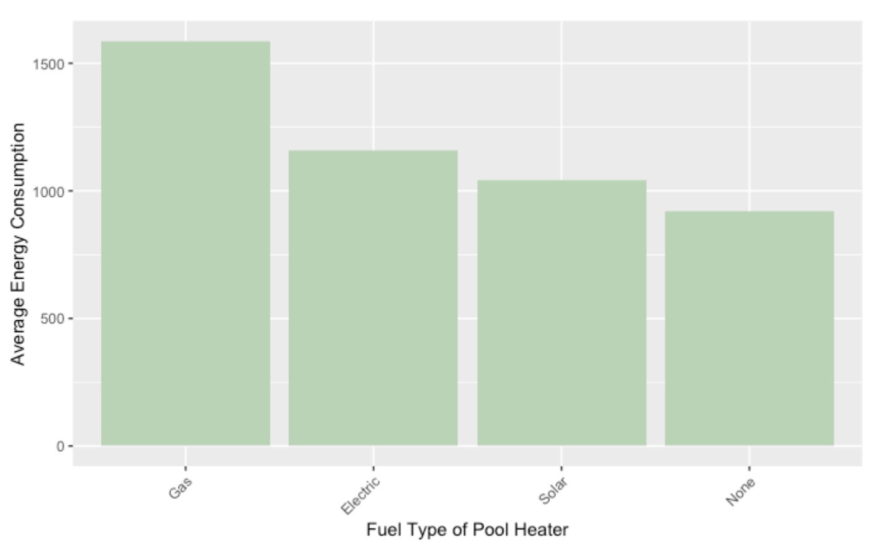
Recommended Fuel Type of Pool Heater - Solar

Slide 23
Average Energy Consumption vs Range of Income
As household income range increases, the house typically uses more energy

Slide 24
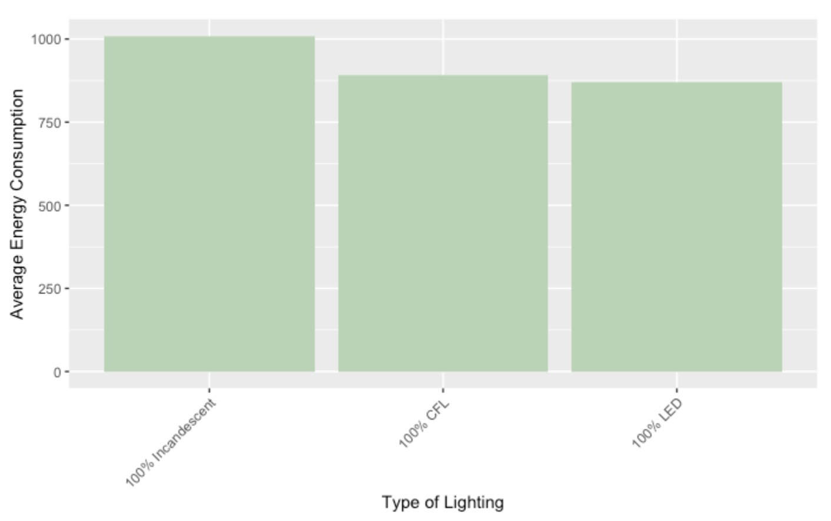
Secondary Recommendation - LED lights

Slide 25

Thank you!

